Slide 1

DEPARTMENT OF COMPUTER SCIENCE AND ENGINEERING
PROJECT TITLE
Health insurance claim prediction using
Machine learning
TEAM MEMBERS:
N.PADMAVATHI(20G01A0552)
A.PAVANI(20G05A0503)
MACHA SIVAKUMAR(20G01A0542)
T.BHARATH KUMAR(20G01A0571)
BATCH CODE:CS20A10
UNDER THE GUIDANCE:
S.NATESAN (MTech PhD)

Slide 2
Contents :
ABSTRACT
INTRODUCTION
LITERATURE SURVEY
OBJECTIVES
PROBLEM STATEMENT
EXISTING SYSTEM
DRAWBACKS
PROPOSED SYSTEM
ARCHITECTURE
MODULES EXPLANATION
UML DIAGRAMS
FEATURE ENHANCEMENT
RESULTS(OUTPUT SCREENS)
CONCLUSION
REFERENCES

Slide 3
Abstract :
The health spending in the US is the highest among all developed nations in absolute numbers as well as a percentage of the economy.
We will develop a medical price prediction system using machine learning algorithms which will aid in steering patients to cost effective providers and thereby curb health spending.
The prediction of the medical price will be done using implementing linear regression algorithm in machine learning.
Additionally, we plan to include the experiments on the same data with other machine learning models such as decision trees and linear regression and compare results.

Slide 4
Introduction :
Insurance is a policy that helps to cover up all loss or decrease loss in terms of expenses incurred by various risks.
This research work considers the insurance dataset obtained from kaggle for developing our prediction model .
These models have been trained to predict the amount that can be claimed by and individual based on their basic information as parameters provided.
This module developed by using python and machine learning libraries such as scikit-learn and tensor flow.

Slide 5
Literature Survey :
In 2018, mahammadfauzan during this paper, the truth of XGBOOST is applied in predict statements. Compare the output with the performance of XGBOOST, a group of techniques.
Example : Random Forest
Mistreatment publicaly accessible urban center seguro to kaggle datasets. The dataset includes vast quantities of nan values however this paper manages missing values by medium and median replacement. However, these simple, unprincipled strategies have additionally proved to be biased.

Slide 6
Objectives :
The objective of health insurance cost prediction system are :
To predict the health insurance of a patient.
To showcase which patients get more health insurance.
To help the insurance agency to calculate the insurance of patients.

Slide 7
problem statement :
In the realm of healthcare, the efficient processing of insurance claims is critical for both insurers and policyholders.
The challenge lies in accurately predicting the approval or denial of health insurance claims, leveraging data-driven insights.
The existing manual claim assessment processes are often time-consuming, prone to errors, and lack the ability to swiftly identify potentially fraudulent claims.
Therefore, there is a pressing need for a robust and automated Health Insurance Claim Prediction system that utilizes machine learning algorithms to analyze historical data, assess risk factors, and predict the likelihood of claim approval.

Slide 8
Existing System :
Nowadays, health insurance is emerging as a tool to manage financial needs of people to seek health services. Health insurance is a part of “ personal insurance and general insurance". Decision is also made by themselves and this may lead to errors, and consume lot of time for getting the insurance for their treatment.
Disadvantages :
Doesn't generate accurate and efficient results.
Computation time is very high.
Lacking of accuracy may result in lack of efficient further treatment

Slide 9
Proposed System :
By using this system, we can know their health status and their background details. By those details we can proceed to next step if their details are validated. If they are valid then the insurance will be given. If they are not valid then it will not proceed for giving insurance.
Advantages :
Generates accurate and efficient results.
Computation time is greatly reduced.
Reduces manual work.
Efficient further treatment.

Slide 10
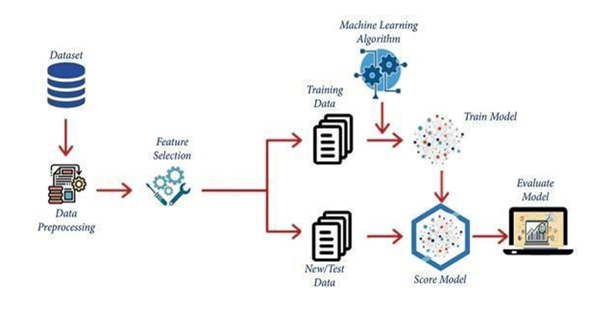
Architecture :

Slide 11
Modules EXPLANATION:
Health insurance claim prediction involves assessing the likelihood of an insurance claim being approved or denied based on various factors.
Data preprocessing module: Handle missing data, Impute or remove missing values.
Exploratory Data Analysis (EDA) module: Analyze and visualize the distribution of features.
Model development module: Choose appropriate machine learning algorithms for classification.
Ensemble learning module: Combine multiple models to enhance predictive performance.
Deployment module: Integrate the predictive model into the existing health insurance claim processing system.
User Interface (UI) module: Develop a user-friendly interface for insurers and claim processors to interact with the system.

Slide 12
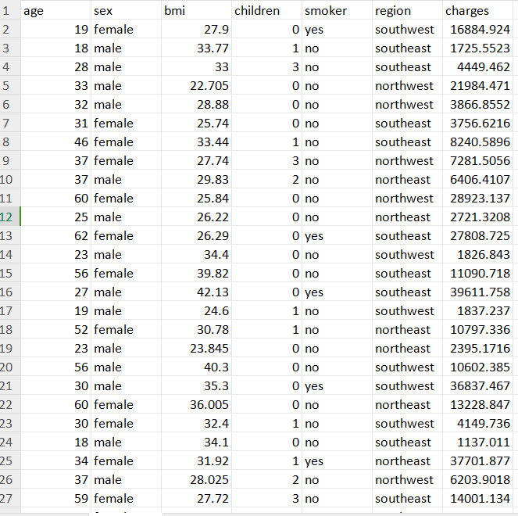
dataset:

Slide 13
UML DIAGRAMS
UML stands for unified modeling language. UML is a standardized general-purpose modeling language in the field of object-oriented software engineering. The standard is managed, and was created by, the object management group.
The goal is for uml to become a common language for creating models of object oriented computer software. In its current form UML is comprised of two major components: a meta-model and a notation. In the future, some form of method or process may also be added to; or associated with, UML.
The uml is a very important part of developing objects oriented software and the software development process. The UML uses mostly graphical notations to express the design of software projects.
Use case diagram
Sequence diagram
Activity diagram

Slide 14
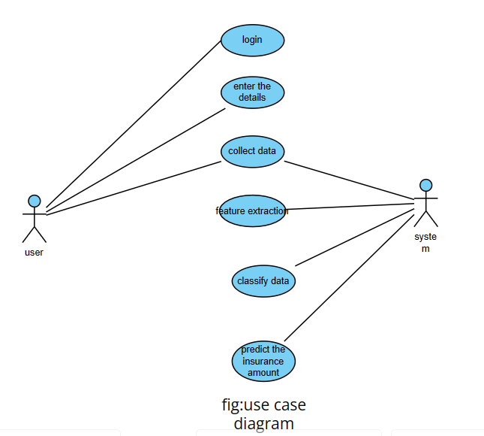
1.Use case diagram
Use case diagrams are a set of use cases, actors, and their relationships. They represent the use case view of a system. A use case represents a particular functionality of a system. Hence, use case diagram is used to describe the relationships among the functionalities and their internal/external controllers. These controllers are known as actors.

Slide 15
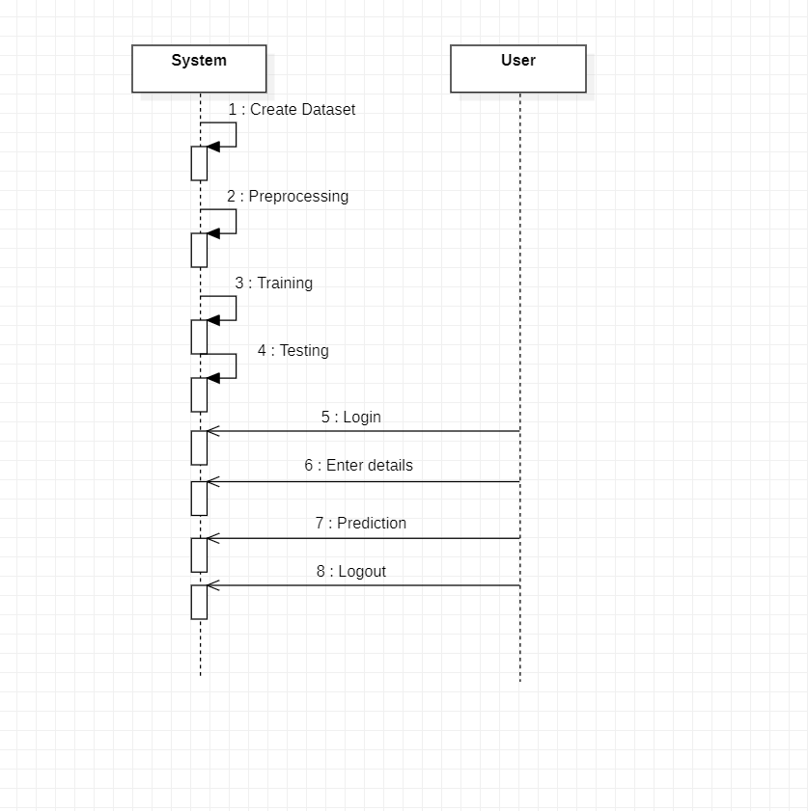
2.Sequence diagram
A sequence diagram is an interaction diagram. From the name, it is clear that the diagram deals with some sequences, which are the sequence of messages flowing from one object to another. Interaction among the components of a system is very important from implementation and execution perspective. Sequence diagram is used to visualize the sequence of calls in a system to perform a specific functionality.

Slide 16
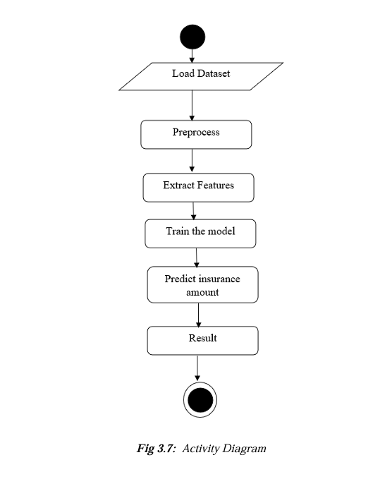
3.Activity diagram
Activity diagram describes the flow of control in a system. It consists of activities and links. The flow can be sequential, concurrent, or branched. Activities are nothing but the functions of a system. Numbers of activity diagrams are prepared to capture the entire flow in a system. Activity diagrams are used to visualize the flow of controls in a system. This is prepared to have an idea of how the system will work when executed.

Slide 17
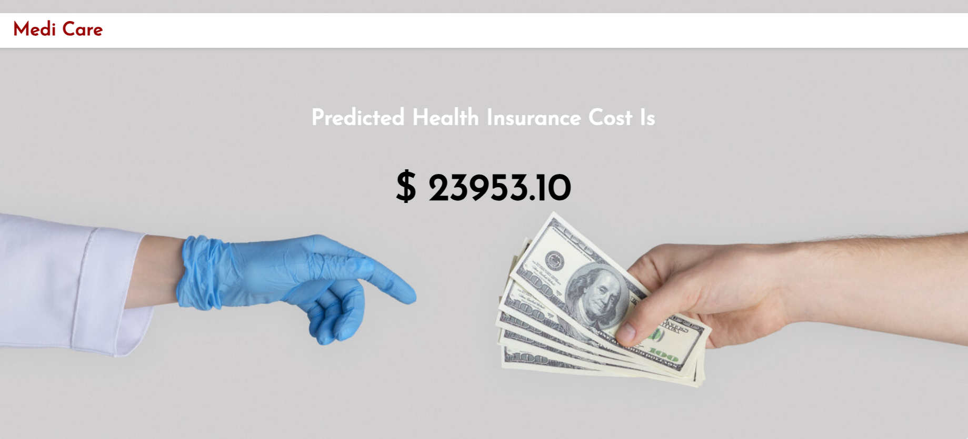
Final output:

Slide 18
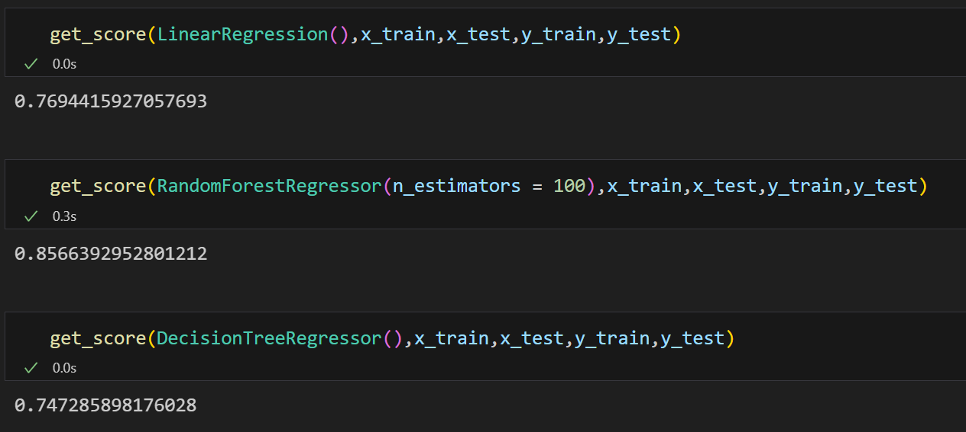
FINAL SCORES:

Slide 19
Future ENHANCEMENT:
Insurance is like net that you pay for ,to protect yourself from financial losses caused by different risk.
If something bad happens , insurance policy kicks into help to cover the costs and lessen the impact on your wallet
We will develop a medical price prediction system using machine learning algorithms which will aid in steering patients to cost effective providers and thereby curb health spending.
The prediction of the medical price will be done using implementing random forest regression algorithm in machine learning.

Slide 20
Conclusion :
The conclusion of this project is to use the designed system to predict the health insurance cost of an individual depending on their input parameters. This model gives high accuracy and hence is good to be adopted in the field of health care and insurance sector.

Slide 21
Reference :
Demsar J. "Statistical comparisons of classifiers over multiple data sets". The journal of machine ta sets". Learning research. 2020:7:1-30.
Mohammad amin morid. Kensaku kawamoto, travis ault, josette dorius, samir abdelrahman "supervised learning methods for predicting healthcare costs" david eccles school of business, university of utah PMCID: PMC5977561 2020.
Pradeep kr.Naveen Aradhya" A collective study of machine learning (ML) algorithms with big data analytics (BDA) for healthcare analytics (HCA)" international journal of emerging trends 2018.
Duncan 1, Loginov M, Ludkovski M. Testing Alternative Regression Frameworks for Prodictive Modeling of Health Care Costs. North American Actuarial Journal. 2019.

Slide 22
Thank you

